Slide 1
Orchestration and Swordfish
Philip Kufeldt
SNIA TC Member
Qiuxin

Slide 2
Background
As enterprises consider on-prem clouds, they initially want to leverage existing assets
Significant number of legacy scaleup storage arrays are leveraged as storage resources in the cloud
These scaleup arrays create silos of data that must be actively managed
Scaleup presents many issues for an orchestration layer needing storage
Heterogeneity, many different scaleup vendors with many different management/provisioning schemes
Active placement decisions, which scaleup array should be selected for any given provisioning request
Growth limitations, what happens when a scaleup array runs out of space
Unbalanced access, what happens when one scaleup array is fielding far more requests than others
No fail in place, scaleup array failures or downtime can directly impact applications
Requires many API adapters (plugins), at least one per storage array type
Scaleout storage systems directly automate these issues
Scaleout will be the markets long term direction
Virtualizing the physical arrays management plane via SDS can ease the pain associated with management and placement
Can not ease any data path issues such as unbalanced access or failure domain¹
1 Data paths/planes are not discussed in this presentation, this strictly examines management plane problems and solutions.

Slide 3
Problems – Orchestration Interaction
Kubernettes
Mesos
Docker
OpenStack
Heat
…
_{V}
_{F}
_{V}
_{F}
_{V}
_{F}
_{V}
_{F}
_{V}
_{F}
_{V}
_{F}
_{V}
_{F}
_{V}
_{F}
_{V}
_{F}
_{V}
_{F}
_{V}
_{F}
_{V}
_{F}
_{V}
_{F}
_{V}
_{F}
_{V}
_{F}
_{V}
_{F}
FMAPI_{v1}
FMAPI_{v2}
FMAPI_{v3}
FMAPI_{vN}
VMAPI_{v1}
VMAPI_{v2}
VMAPI_{v3}
VMAPI_{vN}
Each Plugin Unique
within and across
Orchestration SW
SA_{v1}
SA_{v2}
SA_{v3}
…
SA_{vN}
Orchestration components need plugins for every FMAPI and VMAPI
Orchestrations layers do not have easy API for plugins
Currently plugin support is built into the orchestration layer itself
Orchestration layers change frequently requiring constant
Every orchestration layer will require unique plugins
Key
SA = Storage Array
SAv1 = Storage Array Vendor 1
VMAPIv1 = Volume Management API Vendor 1
FMAPIv1 = File Management API Vendor 1

Slide 4
More Problems – Storage Array Vendors
To write the volume and file plugins Storage Vendors have to:
Possibly write more than one set per array type per orchestration, as different orchestration versions have evolved their storage support requiring different plugins for different versions
Develop strong orchestration product expertise as the plugins are very orchestration specific
These plugins will have to run on virtually every node in the cluster
Because these plugins may be tied into the orchestration software they may end up in tree for the orchestration SW
Some orchestration layers may leave array selection as an app/container decision

Slide 5
More Problems
No common storage scheduling
DevOps should not pick data locations directly
No standard based definition of classes of service
No automated discovery

Slide 6
Openstack Mostly Solved This
Created a shim layer:
Cinder API – Volume Management API
Manila API– File Management API
Each Vendor required to created Cinder and Manila Plugin
Cinder/Manila are specific to Openstack
Change infrequently
Can not be used easily outside of Openstack
Being retro fitted to a stand alone mode for other orchestrations
Cinder has a filter scheduler
Based on characteristics and weights will select best array for the app request
Does not solve all the issues
Endorsed and deployed widely by the community

Slide 7
The Openstack Solution
OpenStack
Nova/Heat
_{F}
_{V}
FMAPI_{Manila}
VMAPI_{Cinder}
Manila
Cinder
_{F}
_{F}
_{F}
_{F}
_{V}
_{V}
_{V}
_{V}
FMAPI_{v1}
FMAPI_{v2}
FMAPI_{v3}
FMAPI_{vN}
VMAPI_{v1}
VMAPI_{v2}
VMAPI_{v3}
VMAPI_{vN}
SA_{v1}
SA_{v2}
SA_{v3}
…
SA_{vN}

Slide 8
A Common Shim solution
Kubernettes
Mesos
Docker
OpenStack
Nova
_{V}
_{F}
_{V}
_{F}
_{V}
_{F}
_{V}
_{F}
FMAPI_{common}
VMAPI_{common}
_{Shim}
_{V}
_{F}
_{V}
_{F}
_{V}
_{F}
_{V}
_{F}
FMAPI_{v1}
FMAPI_{v2}
FMAPI_{v3}
FMAPI_{vN}
VMAPI_{v1}
VMAPI_{v2}
VMAPI_{v3}
VMAPI_{vN}
SA_{v1}
SA_{v2}
SA_{v3}
…
SA_{vN}

Slide 9
Container Storage Interface
Orchestrators last year determined this was a problem
Set out to define a simple shim service has
Common northbound
Stable southbound for array plugins
Cooperative effort – One API to rule them all
Kubernettes
Docker
Mesos

Slide 10
CSI Direction
Node
Node
Node
Node
Node
_{App}
_{App}
_{App}
_{App}
_{App}
_{App}
_{App}
_{App}
_{App}
_{App}
_{App}
_{App}
_{App}
_{App}
_{App}
_{App}
_{App}
_{App}
_{App}
_{App}
_{App}
_{App}
_{App}
_{App}
Master Node
_{CSI}
_{CSI}
_{CSI}
_{CSI}
_{CSI}
_{CSI}
_{CSI}
_{CSI}
_{CSI}
_{CSI}
_{CSI}
_{CSI}
_{CSI}
_{V}
_{F}
_{V}
_{F}
_{V}
_{F}
_{V}
_{F}
_{V}
_{F}
_{V}
_{F}
_{V}
_{F}
_{V}
_{F}
_{V}
_{F}
_{V}
_{F}
_{V}
_{F}
_{V}
_{F}
_{V}
_{F}
FMAPI_{v1}
FMAPI_{v2}
FMAPI_{v3}
FMAPI_{vN}
VMAPI_{v1}
VMAPI_{v2}
VMAPI_{v3}
VMAPI_{vN}
SA_{v1}
SA_{v2}
SA_{v3}
…
SA_{vN}
Container

Slide 11
CSI Problems
CSI defines an abstraction that creates an opaque conduit to Storage Array
Orchestration layer is only concerned with size and name at this point
Container writer must provide array specific blob
Simple provisioning interface only
Even snapshots and replications deferred
No object support
No tenancy
No federation
No storage scheduling
No classes of service
No unified management APIs
No events management
No log management
No performance monitoring
No migration services
If there were only a unified model that dealt with all these …..
Perhaps a tail-walking, bill-shaking, powerful beast ….

Slide 12
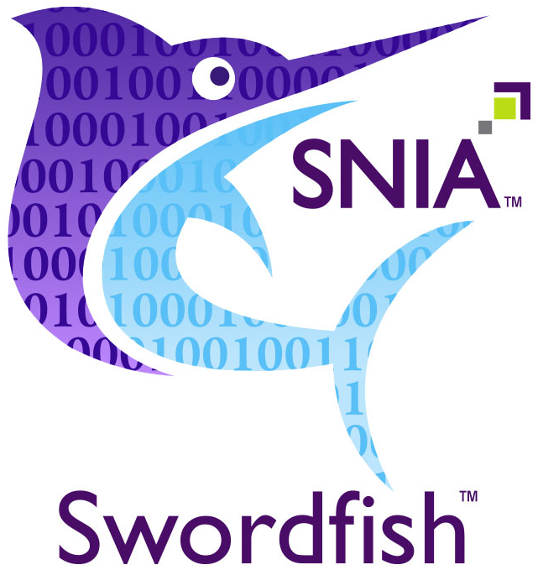
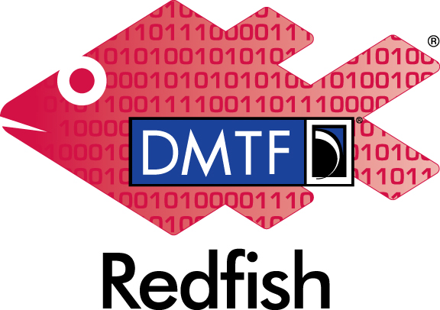
SNIA Swordfish
An extension of
Like Redfish it uses REST, JSON and OData
Provides a Scalable Storage Management Model
Task based, hiding details unless you want to drill down
Model provides for
Organizing an arrays storage service in a standard way
Provisioning of disks, volumes, filesystems, AND shares
TBD: Objects
TBD: Persistent Memory volumes and filesystems
Snapshots and replicas
Events, triggers, logs and performance data

Slide 13
SNIA Swordfish
Swordfish is more than a physical array storage service/management API
It can also be a unifying virtual storage service that is composed of other storage services
This virtualization can hide the details of an ever growing storage tier
One point of management
Standards based
Will interoperate with Swordfish enabled management consoles

Slide 14
A Swordfish Solution
Kubernettes
Mesos
Docker
OpenStack
Nova
_{V}
_{F}
_{V}
_{F}
_{V}
_{F}
_{V}
_{F}
SF API
SF SS
SF SS
_{V}
_{F}
FMAPI_{vN}
SF API
SF API
SF API
VMAPI_{vN}
SA_{v1}
…
SF SS
SA_{v2}
SF SS
SA_{v3}
SA_{vN}
Key
SA = Storage Array
SAv1 = Storage Array Vendor 1
SFAPI = Swordfish REST API
SF SS = Swordfish Storage Service
SF SS

Slide 15
Swordfish Solution
Virtualizes and unifies
Discreet array layer of swordfish and non swordfish arrays is folded into single virtual storage service
Abstracts physical knowledge, unless you drill down
Creates classes of services based on underlying storage services
Focal point for storage management
Can be implemented as a cloud service

